Slide 1

KRAFT COTTAGE

Slide 2

Presented By Tamanna Molla Tanni Nishat Tamanna Dept:EEE Dept:BMB Reg no:2015338006 Regno:2015433004

Slide 3

Website purpose
There are many craft stores,pages & even individuals who want to sell their handmade craft products.This website will be a common platform for the buyer and seller.

Slide 4

Intended Audience
Anyone who wants to buy or sell any kind of craft

Slide 5
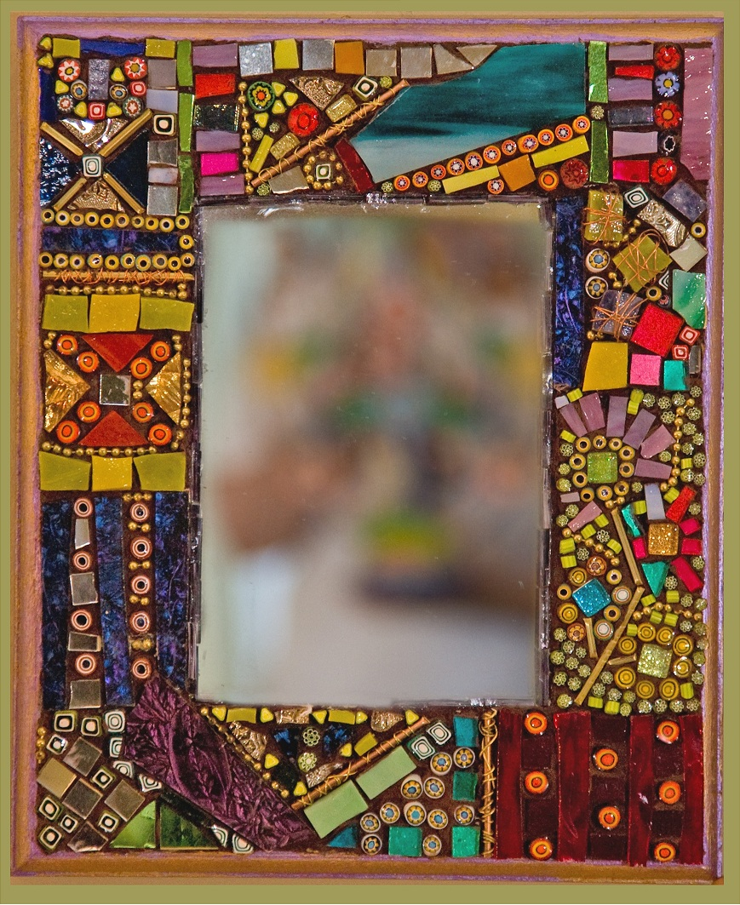
Users
Admin:
Controlling the maintenance of the website.
2. Seller:
Individual seller or various stores and pages.
3. Buyer:
Anyone who is willing to buy craft.

Slide 6

Languages used
HTML
CSS
PHP
JAVASCRIPT
DATABASE

Slide 7

Requirements
Shopping cart
Secured server
Multiple product buying system
Payment system
Craft blog
Product review system
Feedback and rating system
An attractive user interface

Slide 8

Interfaces and Possible Scenario
Buyers Interface
Log in
Registration Interface
Personal Data Editing
Search
Cart
Payment
Logout

Slide 9
Interfaces and Possible Scenario
Sellers Interface
Log in
Registration Interface
Personal Data Editing
Products details
Logout

Slide 10
Interfaces and Possible Scenario
Admin’s Interface
The administrator will have a different log in id using which he can access his account that contains a control panel that allows him to contact each and every aspect of the system.

Slide 11


Slide 12

Thank You

